Slide 1
Notes:
DON’T FORGET TO START DATABRICKS CLUSTER!!!!!

Slide 2
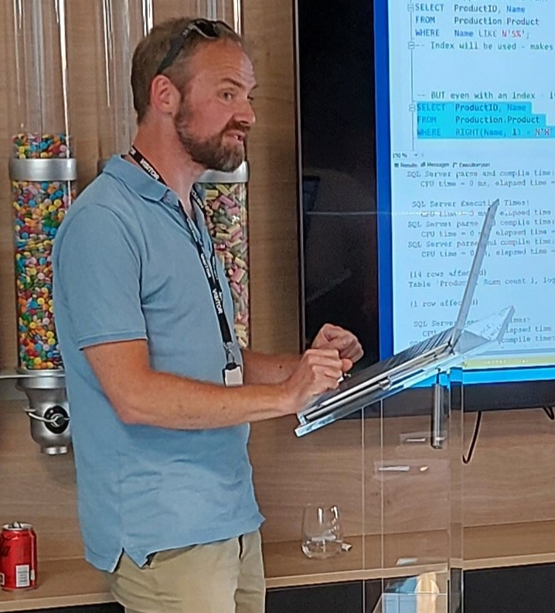

Phil Austin
Senior Consultant
Data & AI

Slide 3
Azure
Go to Azure.com
Click ‘Try Azure for free’
You will need:
An email address
A mobile phone
A credit/debit card – don’t worry you won’t be charged!
Choose United Kingdom or US region
$200 credit / 30 days
Some resources are free longer / permanently
Notes:
DOM

Slide 4
Data engineering using your free credits
Resource group
Notes:
PHIL

Slide 5

Data engineering using your free credits
File
Resource group

Slide 6

Data engineering using your free credits
File
Data Factory
Databricks
Resource group

Slide 7

Data engineering using your free credits
File
Data Factory
Storage Account
Resource group

Slide 8

Data engineering using your free credits
Res
File
Data Factory
Storage Account
Databricks
Resource group

Slide 9
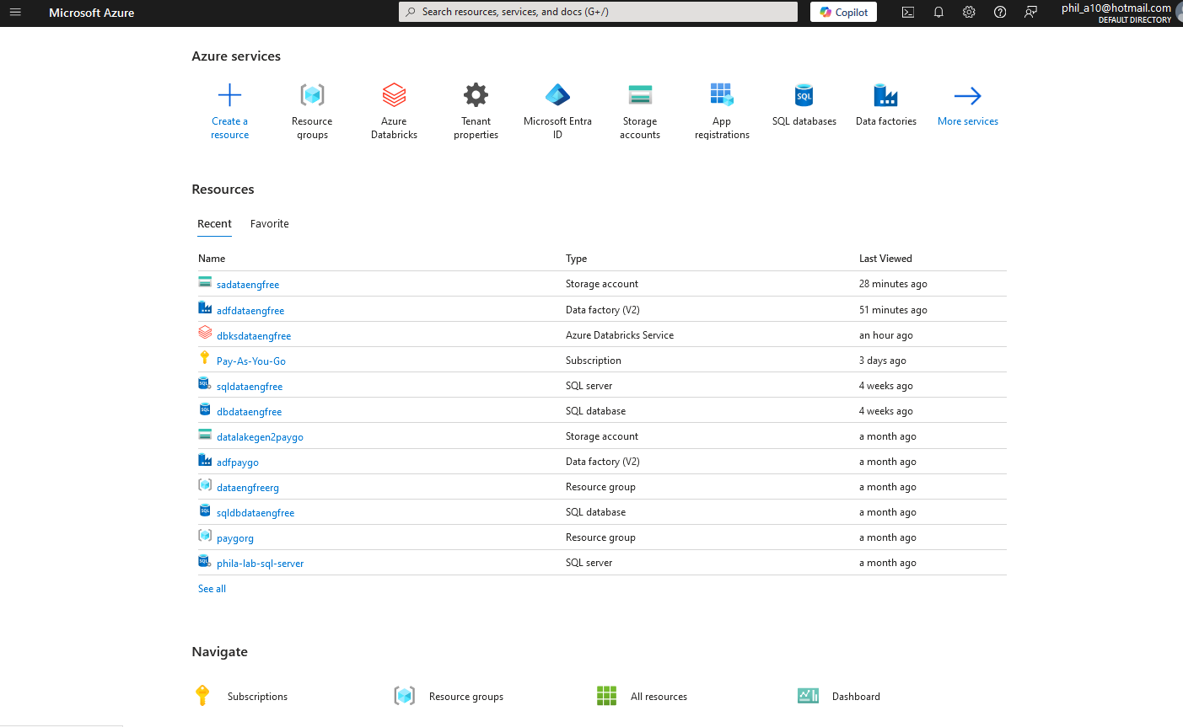
Azure Portal

Slide 10
VS Code
Free download
Very large number of plug-ins/extensions – most free

Slide 11
Azure CLI
Install by following links from: https://learn.microsoft.com/en-us/cli/azure/install-azure-cli
For VS Code:
Azure CLI Tools
Azure Developer CLI

Slide 12
Demo

Slide 13
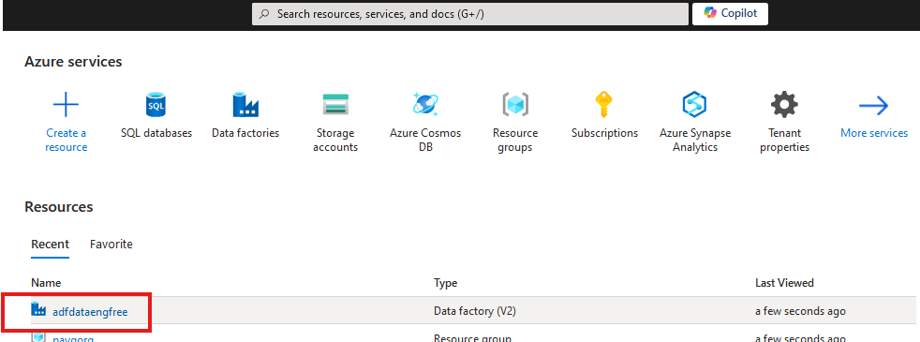


Slide 14
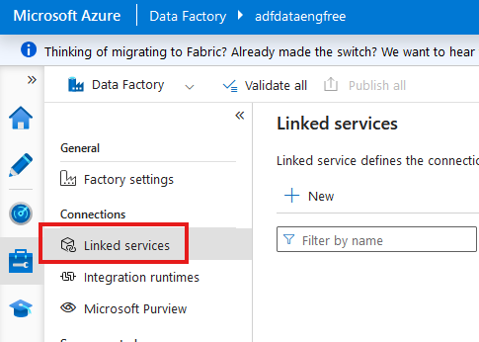

Slide 15
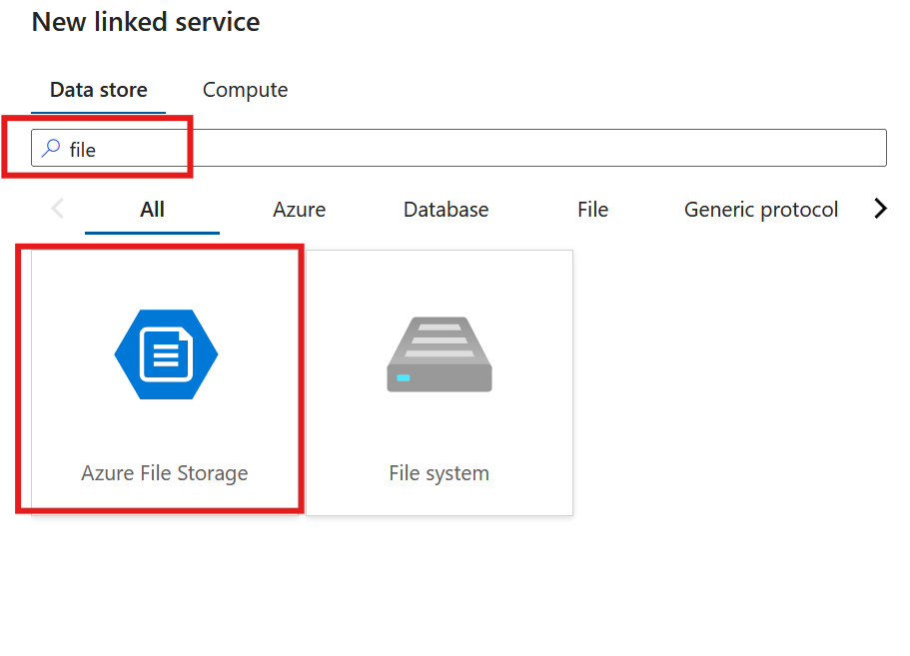

Slide 16
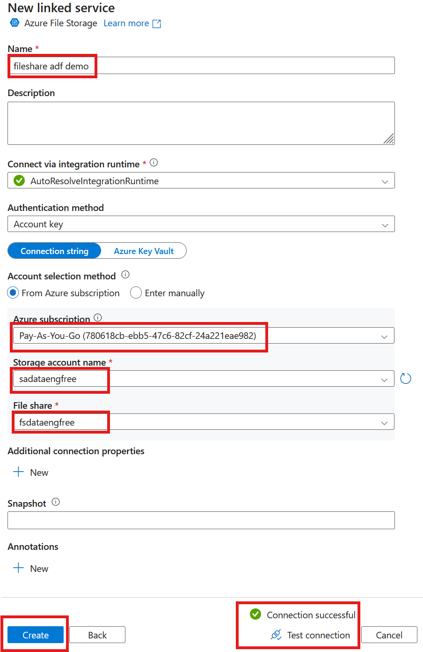

Slide 17
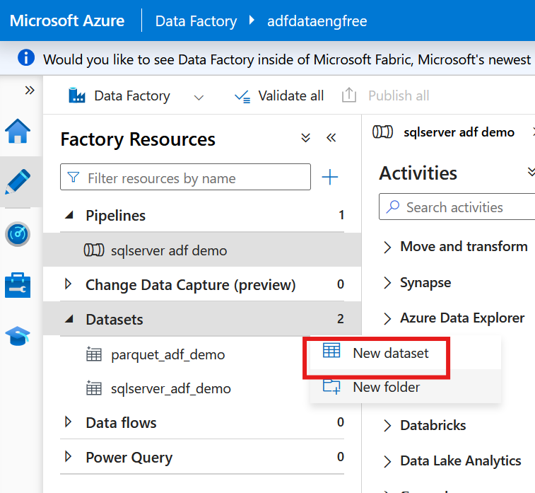

Slide 18
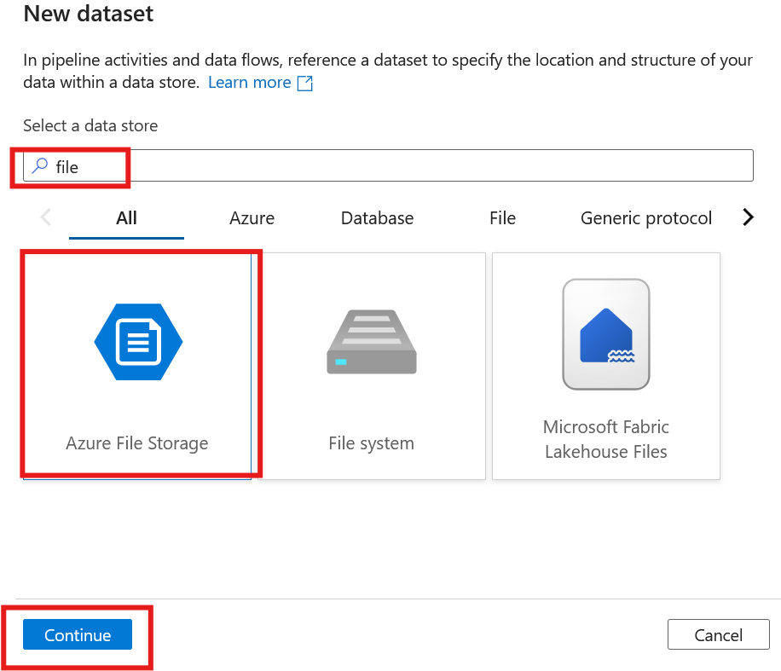
Notes:
S

Slide 19
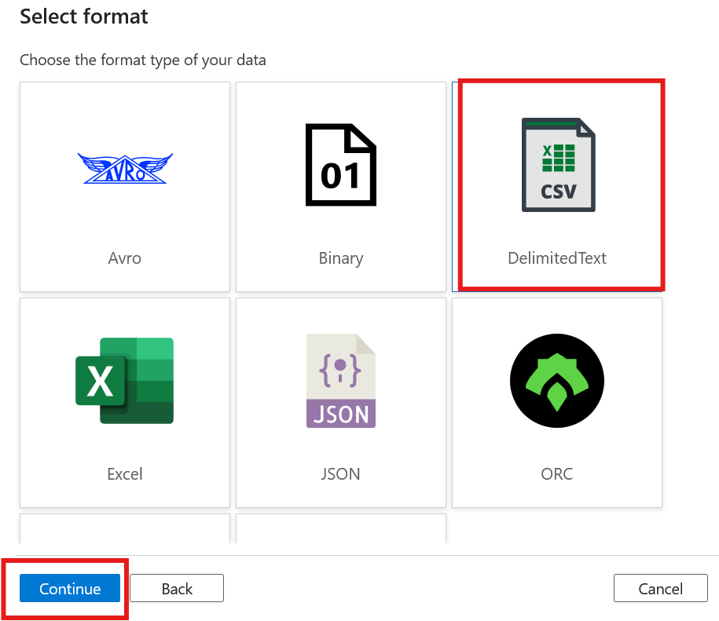

Slide 20
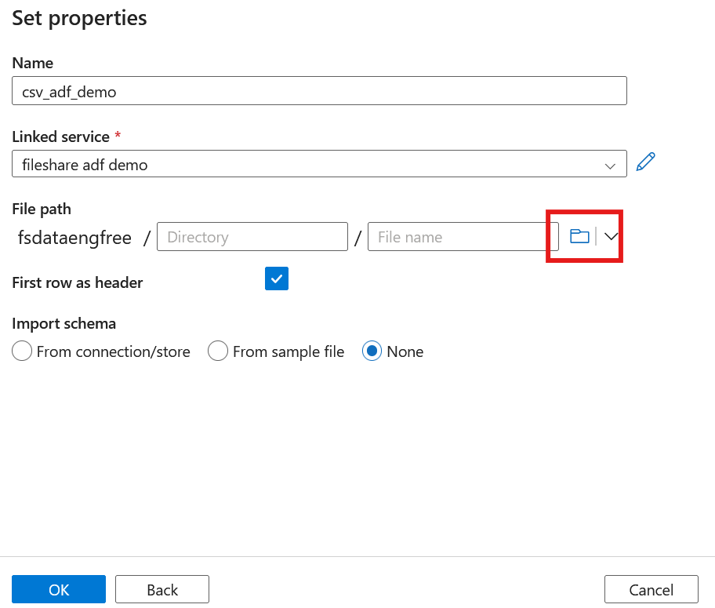
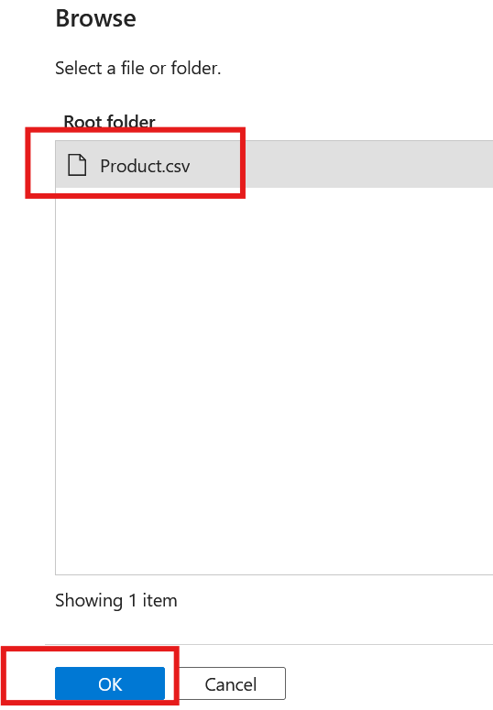

Slide 21
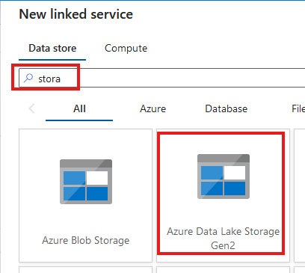
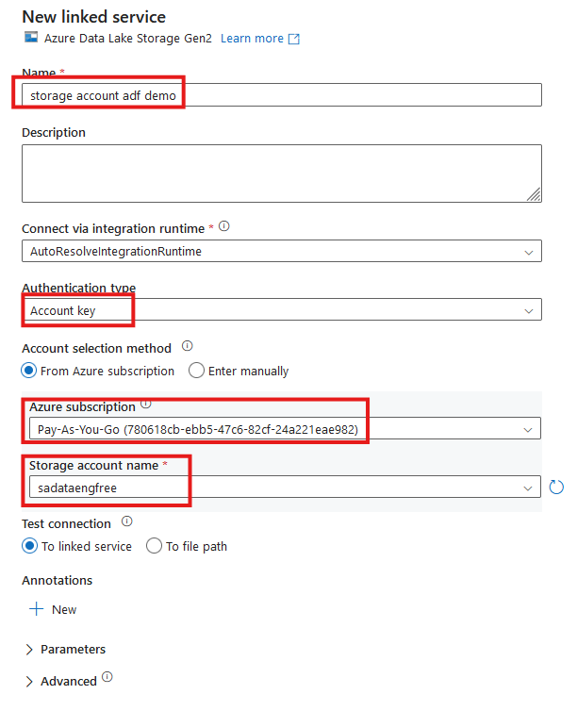


Slide 22
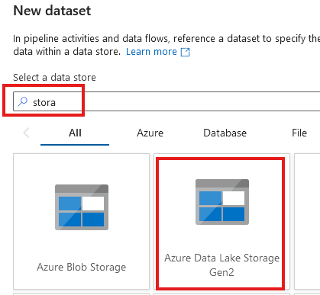
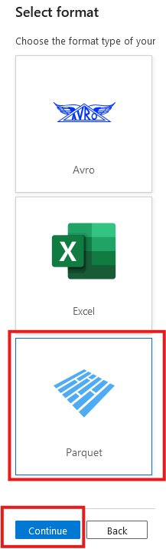

Slide 23
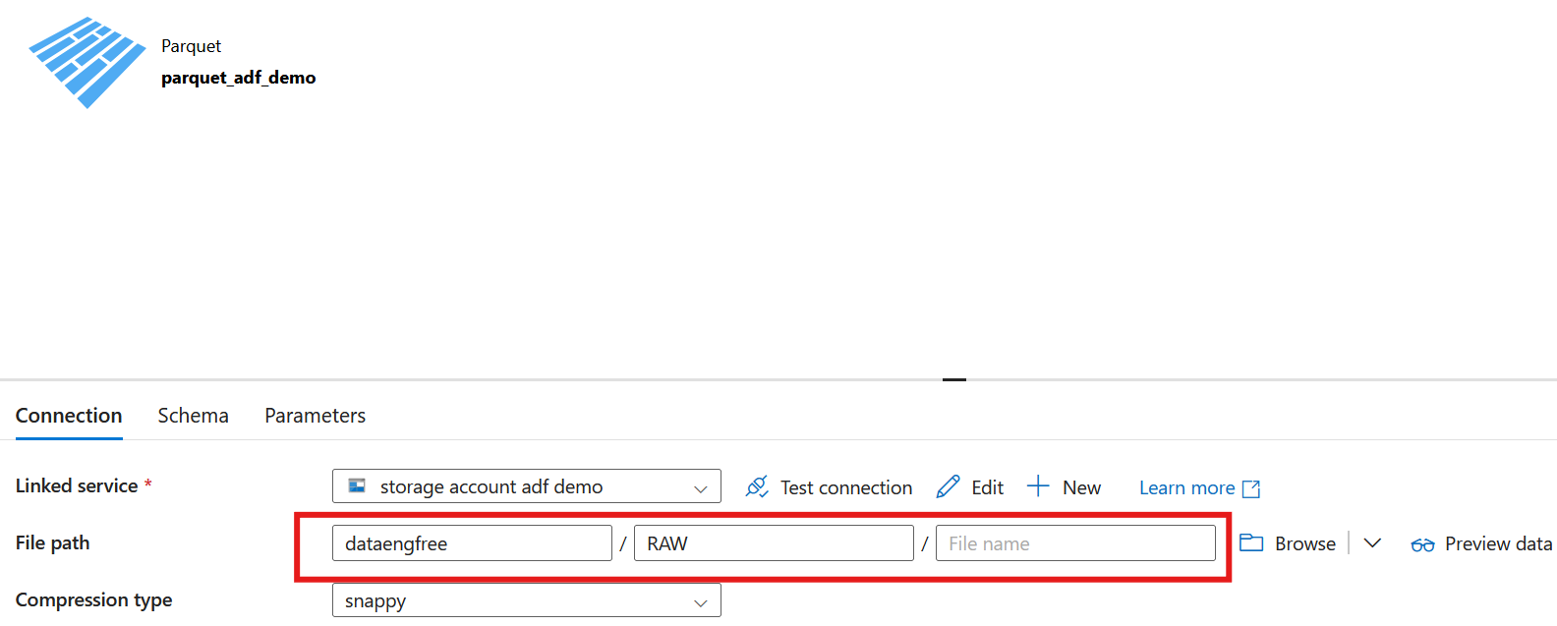

Slide 24
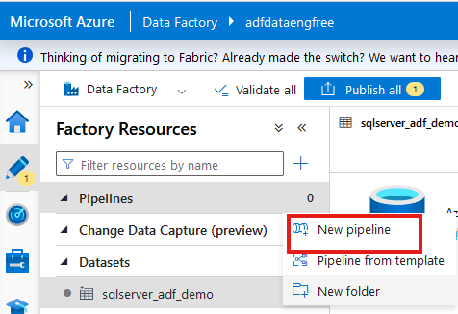
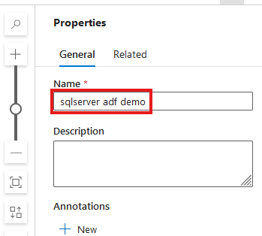

Slide 25
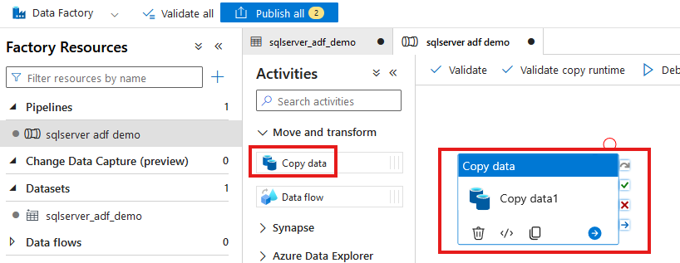

Slide 26
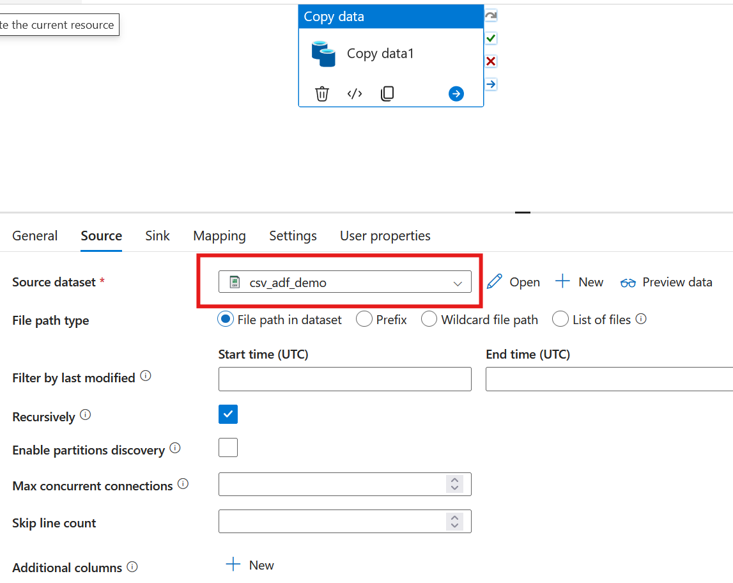

Slide 27
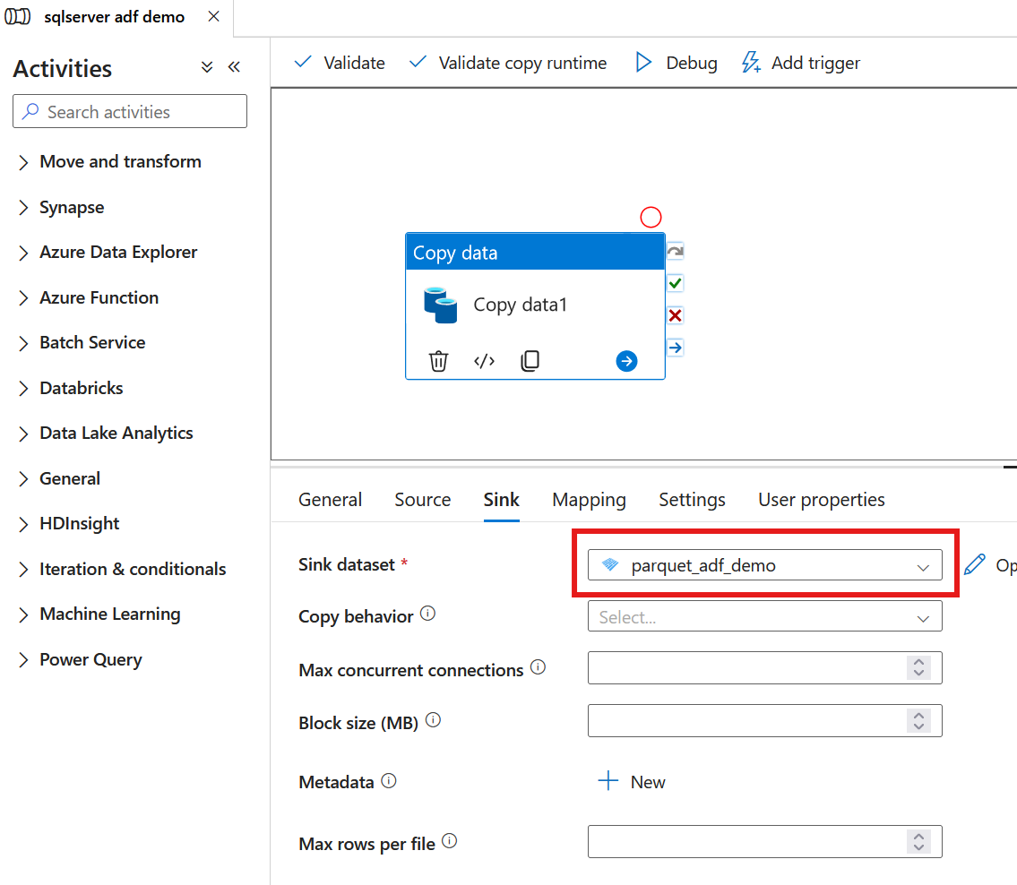

Slide 28
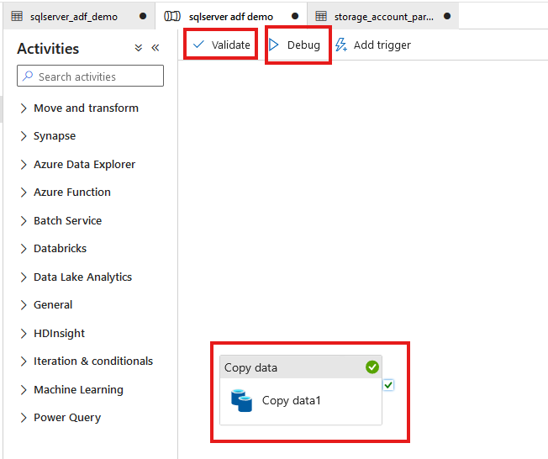

Slide 29
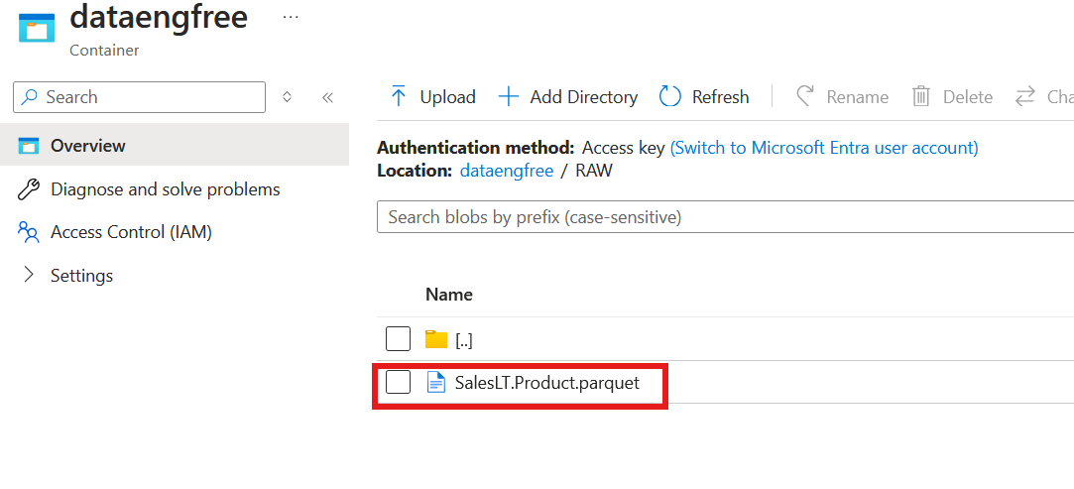

Slide 30
Azure CLI Part II

Slide 31
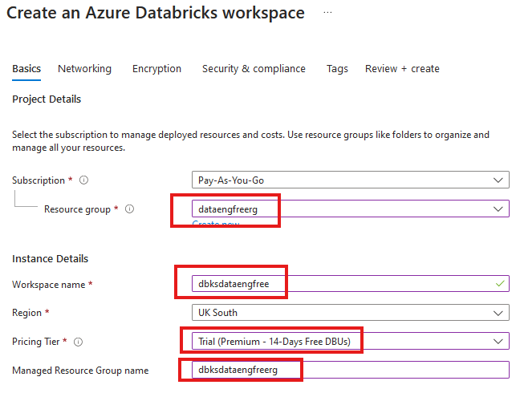


Slide 32
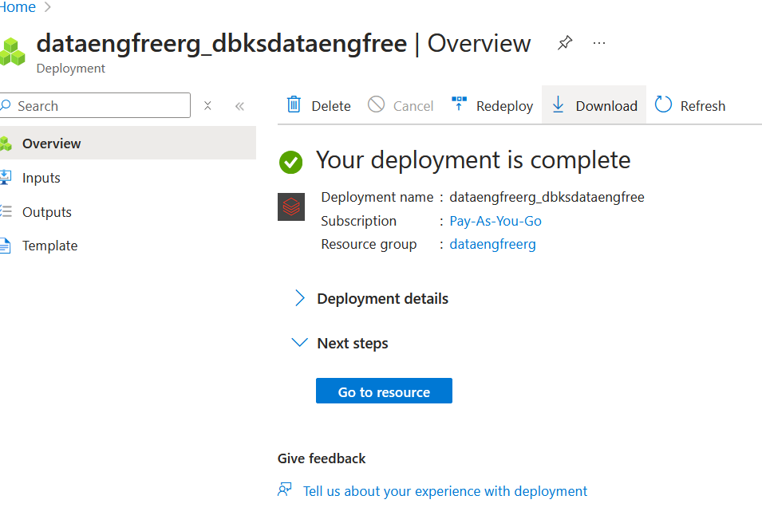

Slide 33
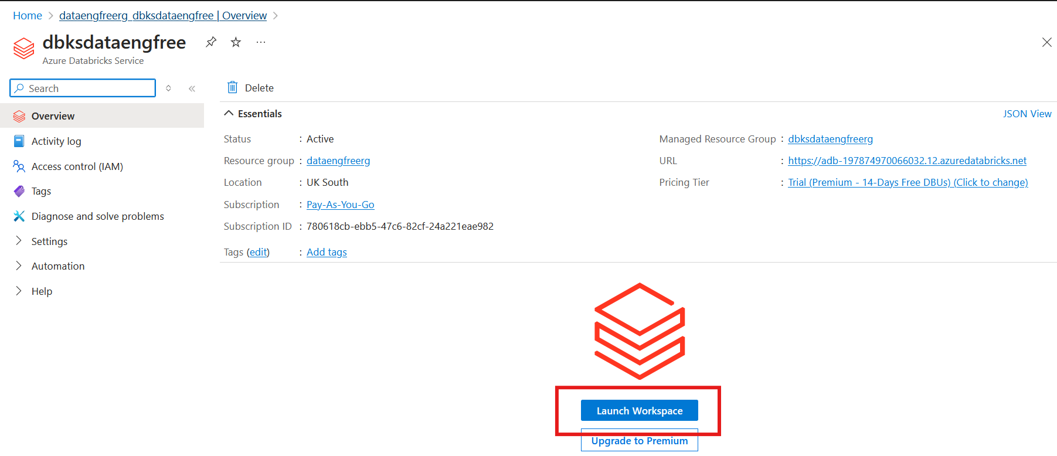

Slide 34
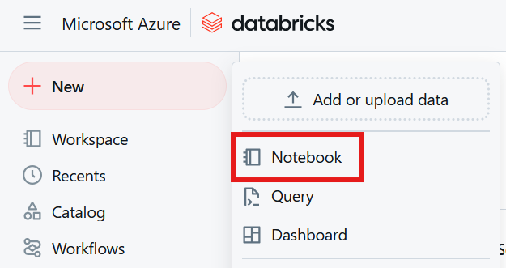

Slide 35
Databricks Demo

Slide 36
Data Engineering locally

Slide 37
Python
What is Python?

Slide 38
Python
What is Python?
Use Anaconda

Slide 39
Python
What is Python?
Use Anaconda
Use conda to create environment

Slide 40
Python
What is Python?
Use Anaconda
Use conda to create environment
Might need to enable Long Paths

Slide 41
Python
What is Python?
Use Anaconda
Use conda to create environment
Might need to enable Long Paths

Slide 42
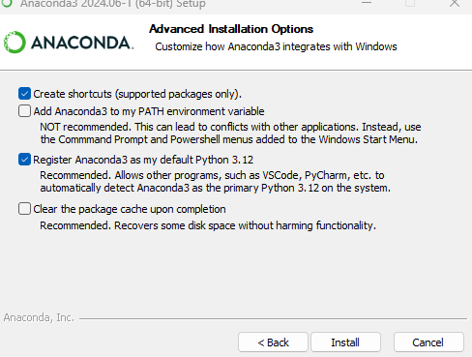
Anaconda install

Slide 43
Conda demo

Slide 44
Apache Spark
Spark

Slide 45
Apache Spark
Spark
PySpark

Slide 46
PySpark Pre-requisites
Install Java v17

Slide 47
PySpark Pre-requisites
Install Java v17
Set paths in environment variables
JAVA_HOME
PATH

Slide 48
PySpark Pre-requisites
Install Java v17
Set paths in environment variables
JAVA_HOME
PATH
Install Apache Spark

Slide 49
PySpark Pre-requisites
Install Java v17
Set paths in environment variables
JAVA_HOME
PATH
Install Apache Spark
Install winutils.exe

Slide 50
PySpark Pre-requisites
Install Java v17
Set paths in environment variables
JAVA_HOME
PATH
Install Apache Spark
Install winutils.exe
Create virtual environment

Slide 51
PySpark Pre-requisites
Install Java v17
Set paths in environment variables
JAVA_HOME
PATH
Install Apache Spark v3.5.3
Install winutils.exe
Create virtual environment
Instructions: https://sparkbyexamples.com/pyspark-tutorial/

Slide 52
PySpark Demo
Uses VS Code
Notes:
PySpark validation
Web UI
VS Code
- to run Jupiter notebooks needs ipykernel installed
- from vscode run conda install -n dataengforfree_env ipykernel
- copy python.exe > python3.exe
Visualisation?

Slide 53
PySpark Demo
Uses VS Code
Needs Jupyter package installed
conda install jupyter
pip install jupyter
Jupyter extension
Notes:
PySpark validation
Web UI
VS Code
- to run Jupiter notebooks needs ipykernel installed
- from vscode run conda install -n dataengforfree_env ipykernel
- copy python.exe > python3.exe
Visualisation?

Slide 54
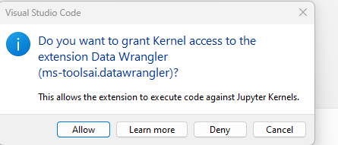

Slide 55
Follow-up Resources
Repo: https://github.com/phil-a10/Talks/tree/main/Data%20Engineering%20Using%20Free%20Tools
Microsoft Learn: https://learn.microsoft.com/en-us/training/career-paths/data-engineer
PySpark instructions: https://sparkbyexamples.com/pyspark-tutorial/
Kimball: https://www.kimballgroup.com/
Downloads
Azure CLI: https://learn.microsoft.com/en-us/cli/azure/install-azure-cli
VS Code
Java
Apache Spark
Winutils

Slide 56
END

Slide 57
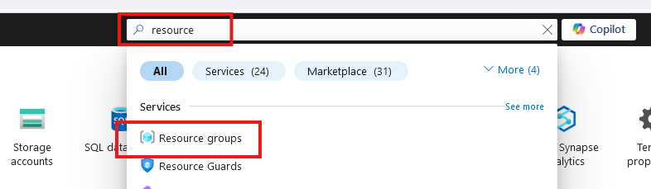
Create Resource Group

Slide 58
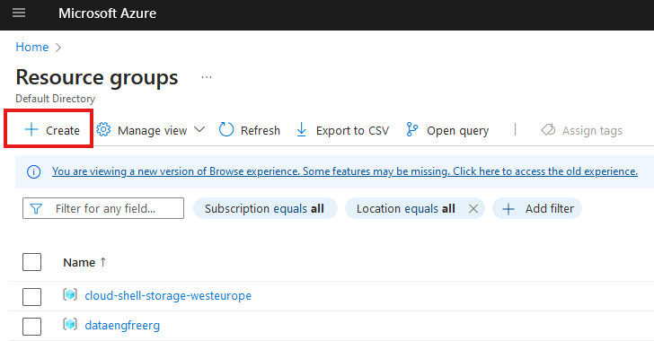
Create Resource Group

Slide 59
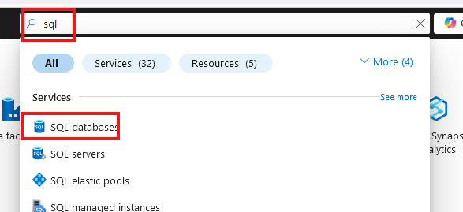
Create SQL database

Slide 60
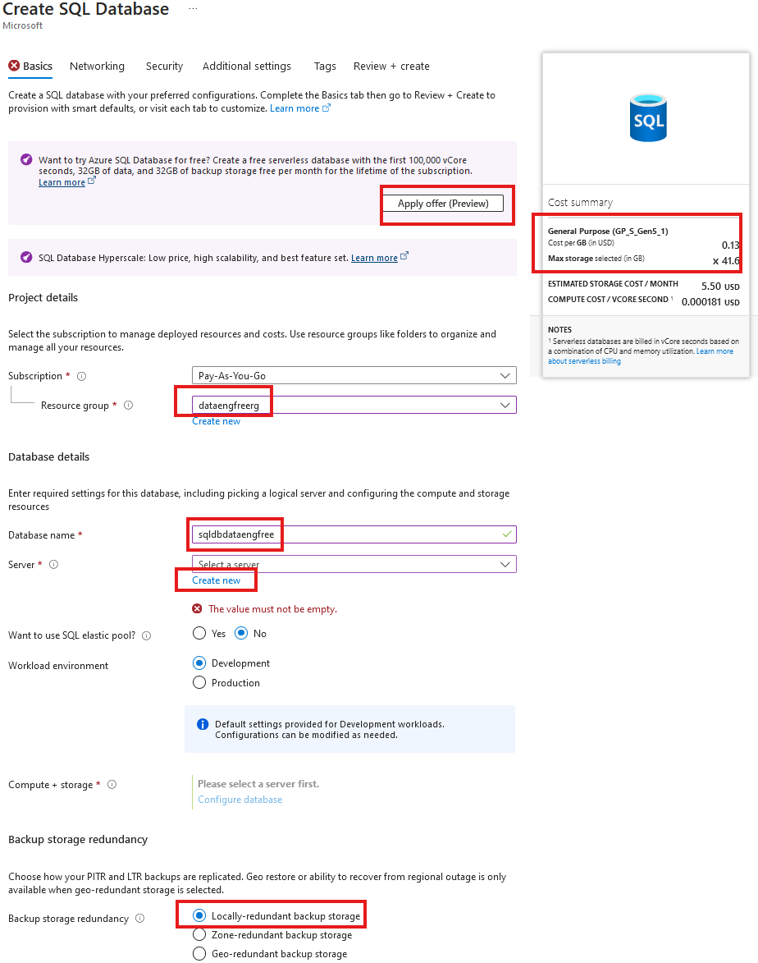
Create SQL database

Slide 61
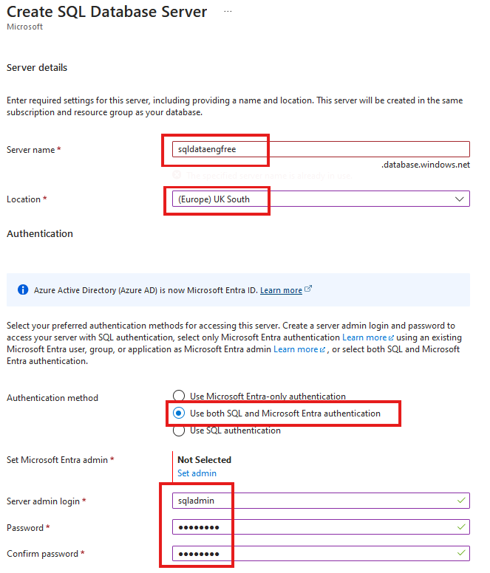
Create SQL database

Slide 62
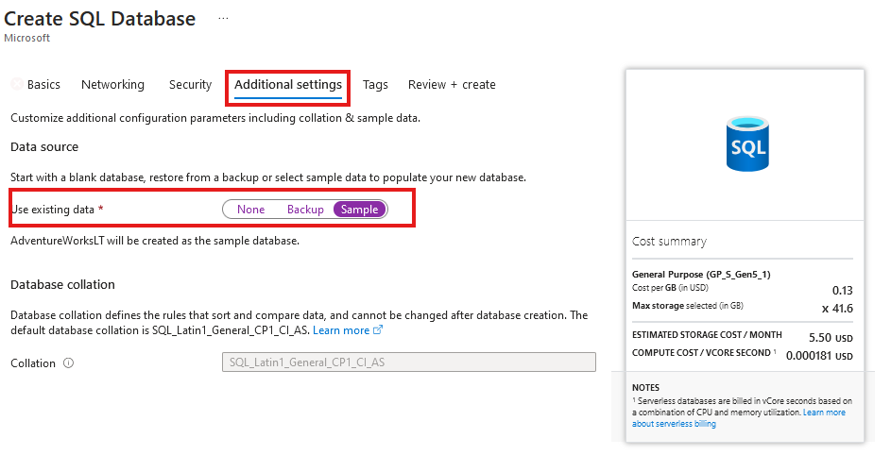
Create SQL database
Add sample data

Slide 63
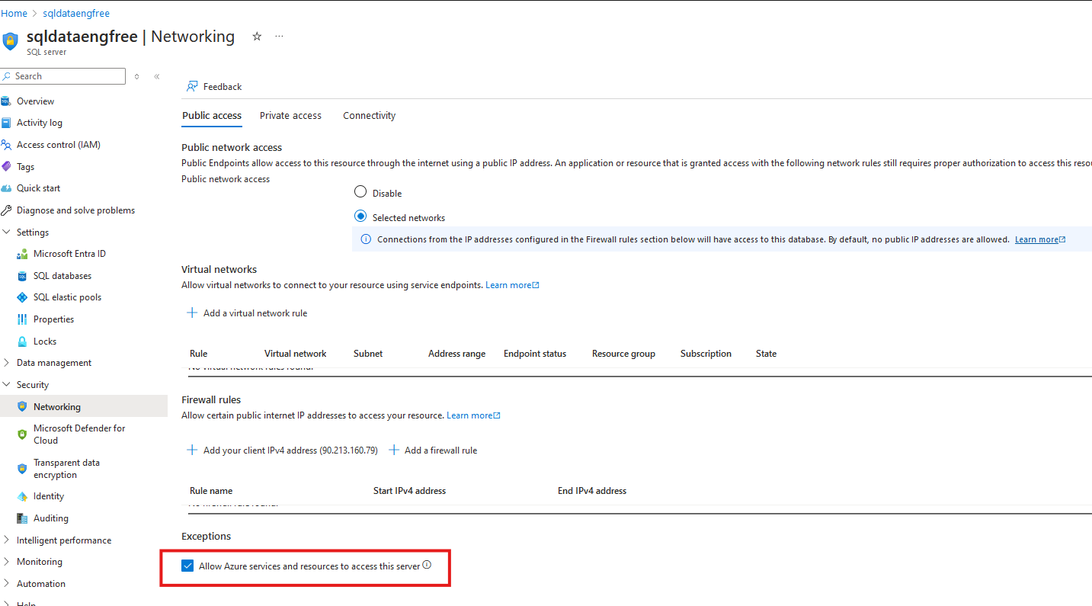
Network setting

Slide 64
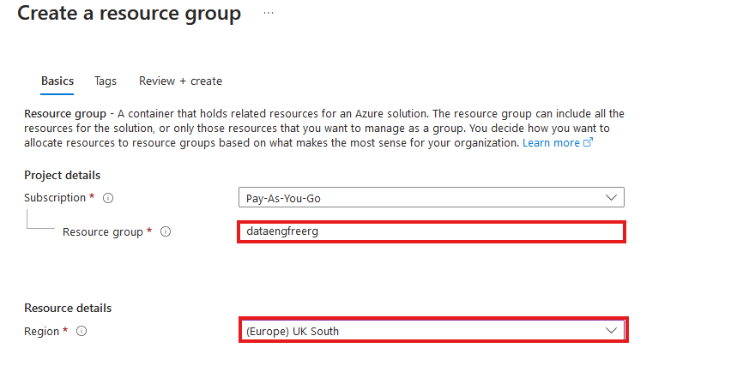
Create Resource Group

Slide 65
Azure CLI Demo

Slide 66
Create storage account
Create in same region as RG
Primary service is ADLS Gen 2
Primary workload Big Data Analytics
Performance: Standard
Redundancy: LRS
Add container > RAW directory

Slide 67
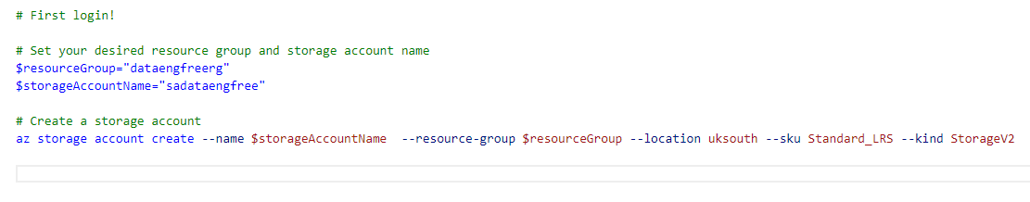
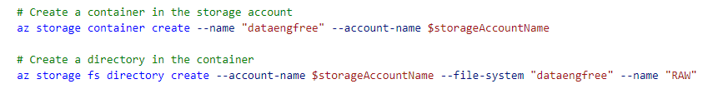
Create storage account

Slide 68
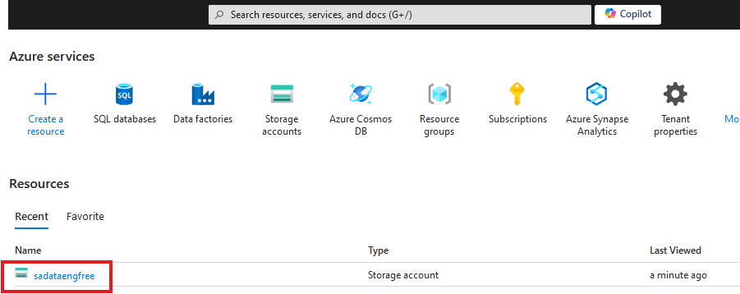

Slide 69
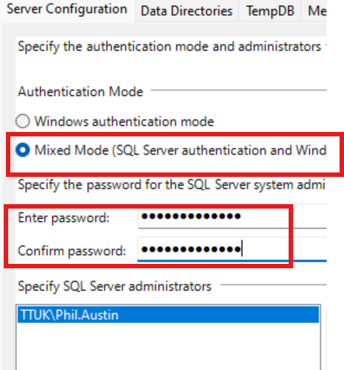

Slide 70
Create Azure Data Factory
Create in same region as RG

Slide 71
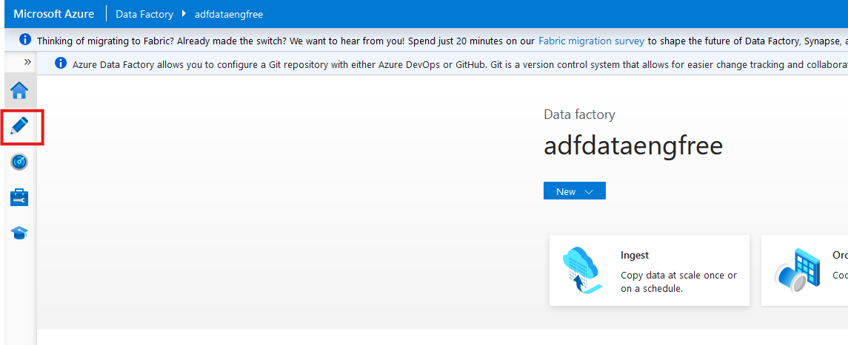

Slide 72
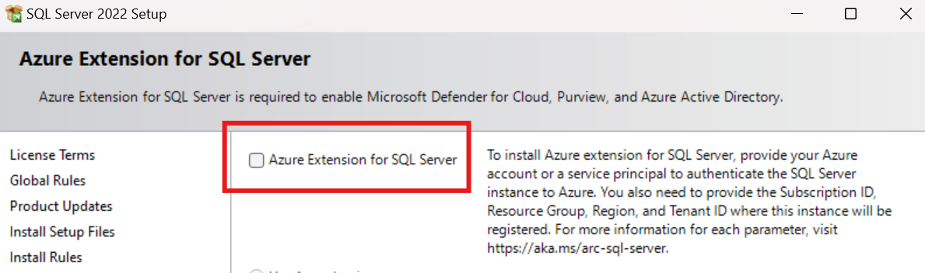
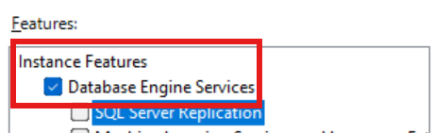
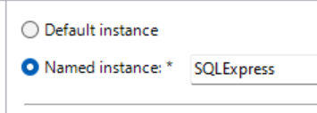

Slide 73
Data & Databases
Concepts to Learn: Data types, databases (SQL and NoSQL), data structures.
Tools/Resources:
Azure SQL Database - free tier available
Cosmos DB: Explore NoSQL databases with a limited free tier on Azure.

Slide 74
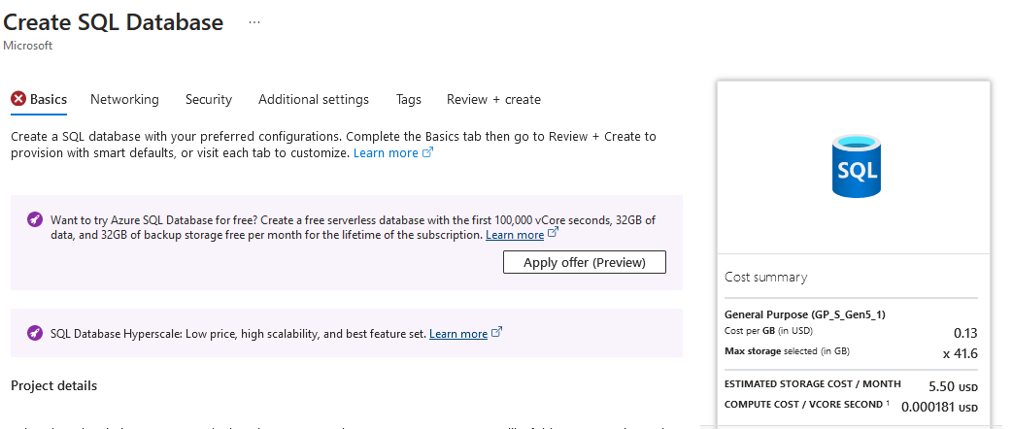

Slide 75
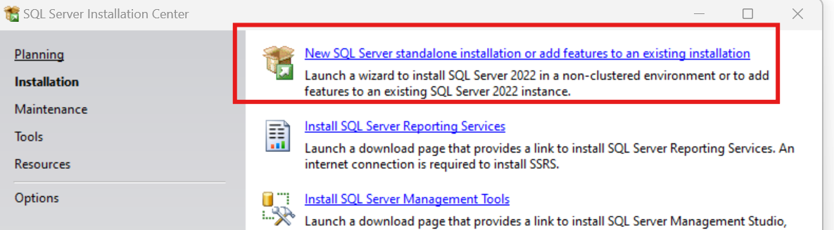
SQL Express!
https://www.microsoft.com/en-us/download/details.aspx?id=104781&lc=1033

Slide 76
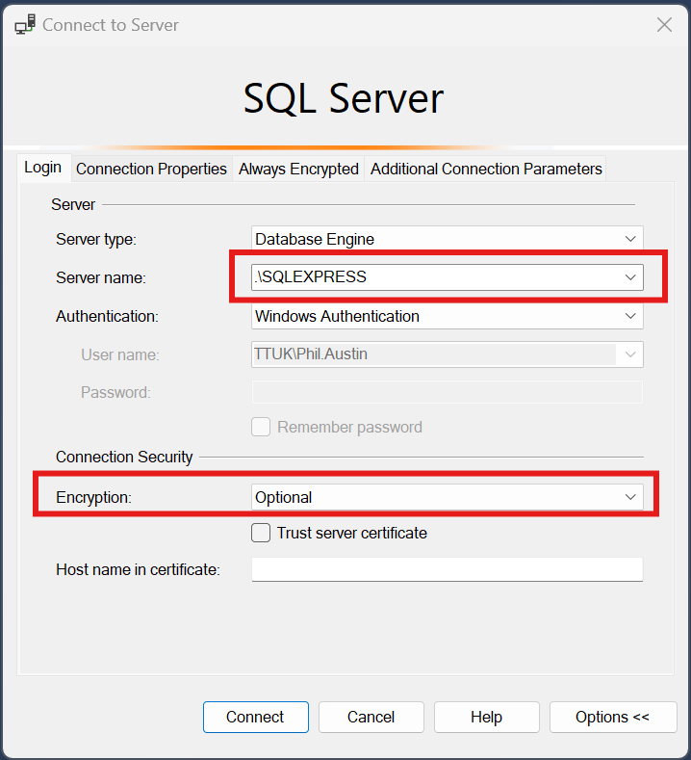

Slide 77
Download JDBC driver: https://repo1.maven.org/maven2/com/microsoft/azure/spark-mssql-connector_2.12/1.2.0/spark-mssql-connector_2.12-1.2.0.jar
Copy jar file to anaconda jars folder

Slide 78
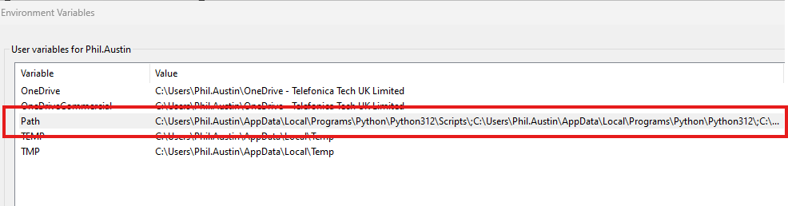
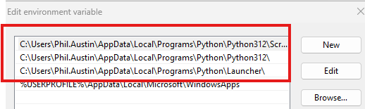
Python pre-reqs

Slide 79



Slide 80



Slide 81



Slide 82


Slide 83


Slide 84


Slide 85



Slide 86


Slide 87

Create storage account

Slide 88

Create storage account

Slide 89

Create storage account

Slide 90



Slide 91


Create Azure Data Factory (ADF)

Slide 92
Create Azure Data Factory (ADF)

Slide 93

Create Azure Data Factory (ADF)

Slide 94


Slide 95


Slide 96


Slide 98
PySpark

